Slide 1



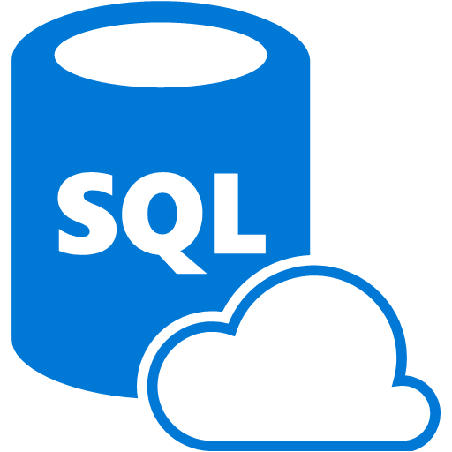
Azure DevOps
Application Insights
Azure Repos
Azure Web Apps
Azure DevOps with GitHub
Azure SQL Database
SOURCE CONTROL
CI
PACKAGE
PIPELINE
DEPLOYMENT

Slide 2




Tailspin Toys, Inc.
Current Process
Azure App Service with Web App
(S3 Instance)
Azure DevOps
Visual Studio / FTP
Manual internal code review & QA on local developer machines
development
test
master
Azure SQL Database
(S1 Instance)

Slide 3


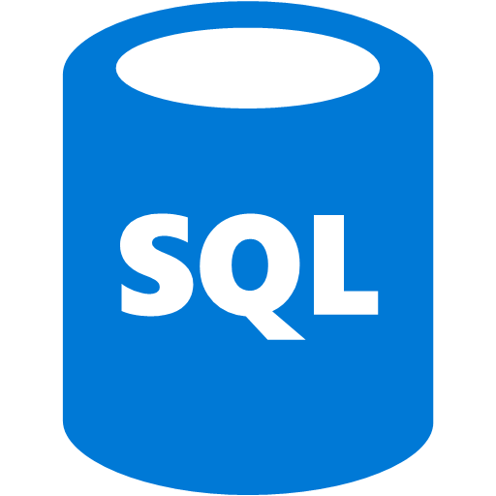
Preferred solution
Azure
Azure DevOps
development
App Service
Azure SQL
test
Build (+tests)
Release Management
Edit code
Commit and push local branch to Azure DevOps
Create a Pull Request for peer review
Merge to master
production
App Service
Azure SQL
Continuous Integration
Continuous Deployment
App Service
Azure SQL
Application Insights

